Slide 1






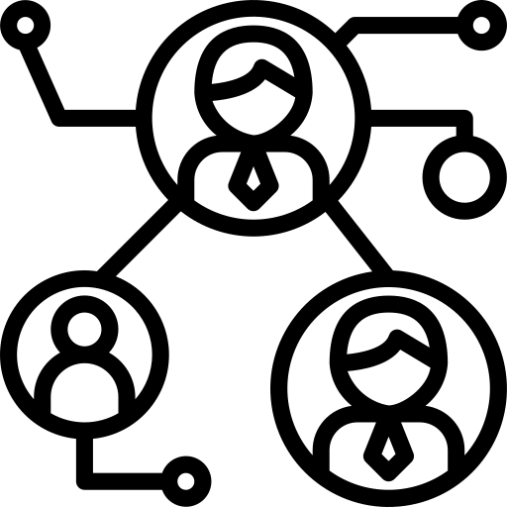



Create a List Of Ideal Sponsors
Use Digital Tools to find Reliable Solutions
Be Specific About Goals, Vision and Demographics
Build a List of Targeted Prospects
Identify audience
Craft a Selling Proposition
Connect with Event Sponsors
Design your event to attract Sponsors
Build a Long term relationship to keep Sponsors
Keep Informed
Share ROI

